Slide 1

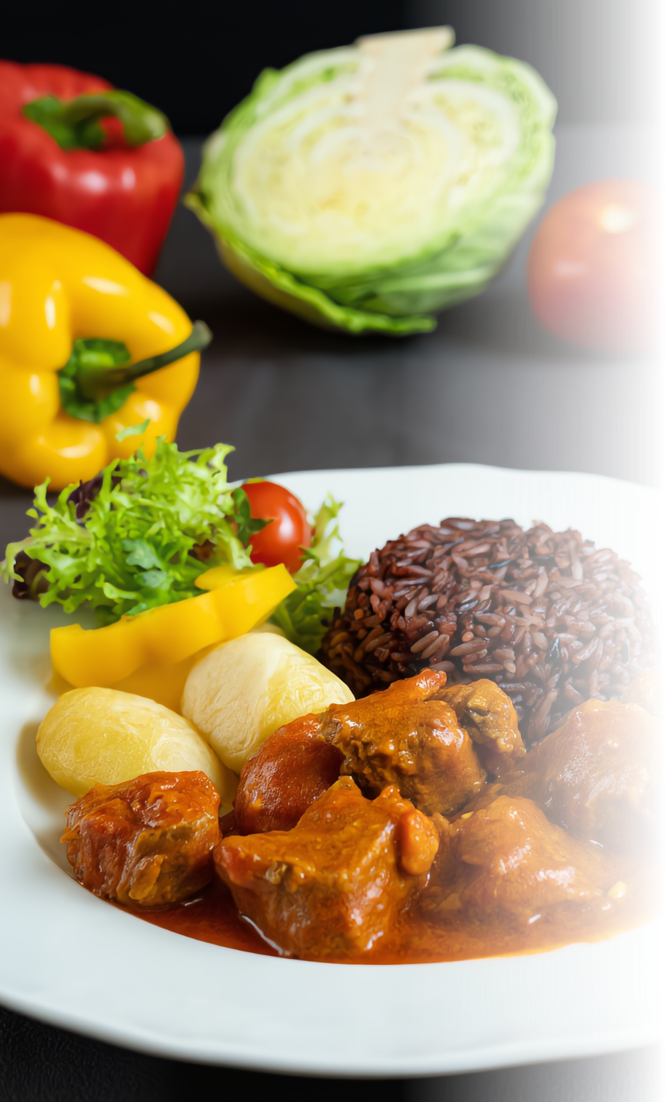
Diet Recommendation System
Presented by:
Laxmikant Dhanka(0101CS211070)
Pandey Nabh Akhilesh(0101CS211091)
Sahil Mansoori(0101CS211105)
Syed Asim Ali(0101CS211123)

Slide 2
Problem Statement
Individuals often struggle to maintain a balanced and nutritious diet due to lack of awareness, personal preferences, medical conditions, or lifestyle constraints. Without proper guidance, they may consume excessive unhealthy foods or miss essential nutrients, leading to health issues such as obesity, deficiencies, and chronic diseases.
This project aims to develop a personalized diet recommendation system that provides tailored meal plans based on individual needs, health goals, and dietary restrictions to promote better nutrition and overall well-being.

Slide 3
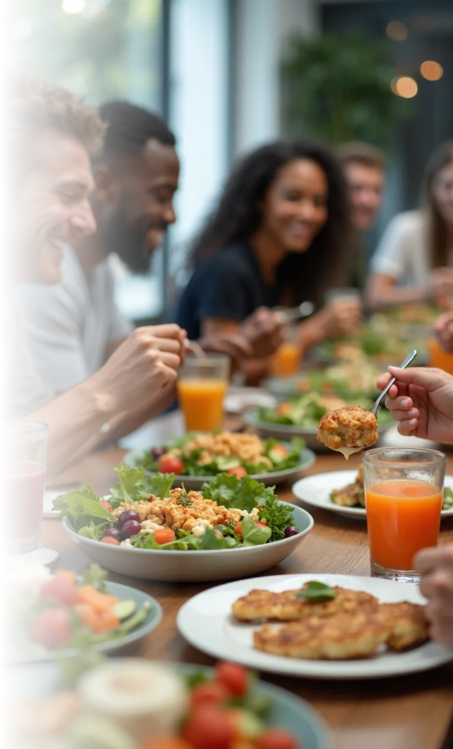
System Overview
This system is designed to provide personalized dietary recommendations aimed at helping users meet their health objectives. By using advanced technologies, it tailors meal suggestions based on individual preferences and health conditions.
Purpose and Goals
Helping users achieve health goals through tailored dietary recommendations.
Target Audience
Catering to users seeking weight loss, muscle gain, or improved health conditions.
Technological Integration
Leveraging AI and machine learning to analyze data and deliver suggestions.

Slide 4




User Input Collection for Meal Plans
1
Personal details
Basic details like age, height, weight, gender of the user.
2
Health Goals
To consider health parameters like blood sugar and pressure.
3
Lifestyle Factors
Consider activity level and cooking skills for manageable meal plans.

Slide 5
Technology used
Front End :
User Interface (HTML/CSS + Streamlit)
Input Collections
User health data and personal user details using Pandas, Numpy
Processing Unit
Leveraging machine learning model like Decision tree, k means clustering generate to analyze data and deliver suggestions.
Output
Output containing Recommended Diet Plan

Slide 6



Data Analysis and Processing
ML Algorithm Development
2
Advanced algorithms like Decision tree, k means clustering generate optimal meal plans based on user inputs and dietary guidelines.
Food dataset
Accesses a comprehensive database of food items for accurate meal planning.
1
Food recommendation
3
Continuous user recommendation refines meal recommendations for better personalization.

Slide 7
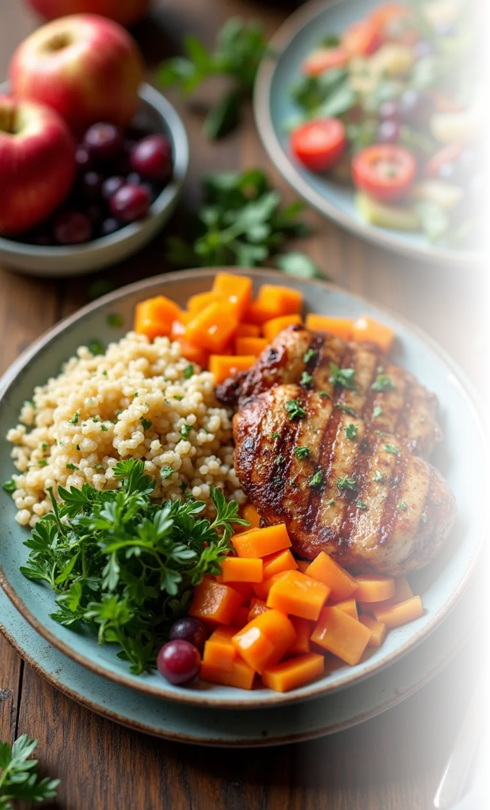



Key Features
Health-aware recommendations
ML-powered personalization
Easy-to-use web interface
The system emphasizes portion sizes tailored to individual caloric needs, promoting healthy eating without deprivation.
Recommendations focus on creating meals that strike a balance between carbohydrates, proteins, and fats while ensuring adequate vitamins and minerals intake.
Encouraging users to try diverse recipes and seasonal produce enhances motivation and adherence to the meal plan.

Slide 8



User Engagement and Interface
Interactive Features
2
Engaging tools like meal reminders and grocery lists.
User-Friendly Design
1
An intuitive interface ensures easy navigation.
Progress Tracking
3
Users can monitor dietary habits and health progress.

Slide 9
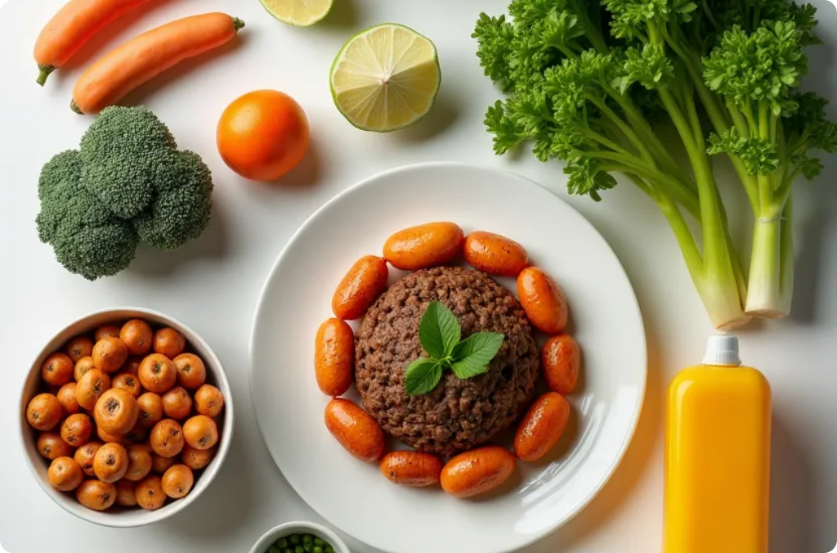


Challenges and Solutions
Individual Variation
User Engagement
Data Privacy
Addressing the diverse nutritional needs and preferences of users can be complex. The system continually updates algorithms and databases to accommodate this diversity.
Ensuring sustained user engagement is crucial. Regular updates, engaging content, and community features can foster ongoing interaction and commitment.
Safeguarding user data is paramount. Implementing robust privacy measures and transparent data practices will enhance user trust.

Slide 10



Future Directions
Expansion of Food Database
2
Continuously expanding food database and recipe options for user variety.
Integration with Wearable Devices
1
Integrating data from wearable fitness devices for accurate recommendations.
Research and Development
Ongoing research into dietary trends ensuring up-to-date recommendations.
3

